Slide 1
Research agent
IBM HACKATHON PROJECT
Presented By-
Student name :Aditya Ohdar
College Name & Department : (ITER) Siksha O Anusandhan University (C.S.E)

Slide 2
OUTLINE
Problem Statement
Technology used
Wow factor
End users
Result
Conclusion
Git-hub Link
Future scope
IBM Certifications
Github Repository Link

Slide 3
Problem Statement
Research Agent
A Research Agent is an AI system designed to assist with academic and scientific research tasks.
- Summarizes research papers
- Organizes references
- Suggests hypotheses
- Drafts sections of research reports
This project is built fully on IBM Cloud Lite using Watsonx.ai and the Granite foundation model.

Slide 4
Technology used
IBM Cloud Lite Services
Leveraging scalable, cost-effective infrastructure for seamless deployment and operation.
Natural Language Processing (NLP)
Enabling the agent to understand, interpret, and generate human language from research texts.
Retrieval Augmented Generation (RAG)
Combining retrieval capabilities with generative AI for highly accurate and contextually relevant responses.
IBM Granite Model
Utilizing a powerful foundation model for advanced text understanding and generation tasks.

Slide 5


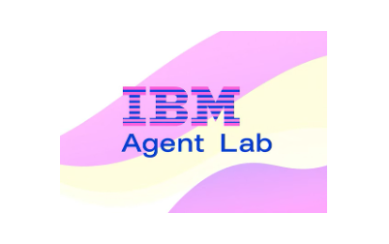

IBM cloud services used
IBM Cloud Watsonx AI Studio
IBM Cloud Watsonx AI runtime
IBM Cloud Agent Lab
IBM Granite foundation model

Slide 6
Wow factors
This agent will significantly reduce research time, improve the quality of literature reviews, help early-stage researchers find direction, and foster interdisciplinary collaboration by making knowledge more accessible and actionable.
Unique Capabilities:
⦿Massive Time Savings: Cuts literature review time by over 70% through instant summarization and reference extraction.
⦿Factual, Grounded AI: Uses vectorized document grounding to ensure responses are accurate and based on uploaded research.
⦿Smart Hypothesis Generation: Suggests innovative research directions from existing literature.
⦿Contextual Q&A: Understands complex academic queries and provides targeted answers with citations.
⦿Multi-format Support: Works with PDF, DOCX, and TXT documents without conversion hassles.
⦿Scalable for Any Domain: Adaptable to medicine, engineering, AI, climate research, and more.
⦿Seamless Deployment: Fully no-code build on IBM Watsonx.ai, deployable as an API.
⦿Accessible Anytime: Cloud-hosted — usable from any location without local software installation.

Slide 7
End users
Students and Academics
Streamlining literature reviews, discovering novel connections, and accelerating publication cycles.
Research Institutions & Universities
Enhancing productivity, fostering interdisciplinary projects, and improving research output.
Industry R&D Teams
Staying ahead of technological advancements, identifying market gaps, and informing product development.
Librarians and Knowledge Managers
Providing up-to-date resources for curriculum development and guiding students in their research endeavors.

Slide 8
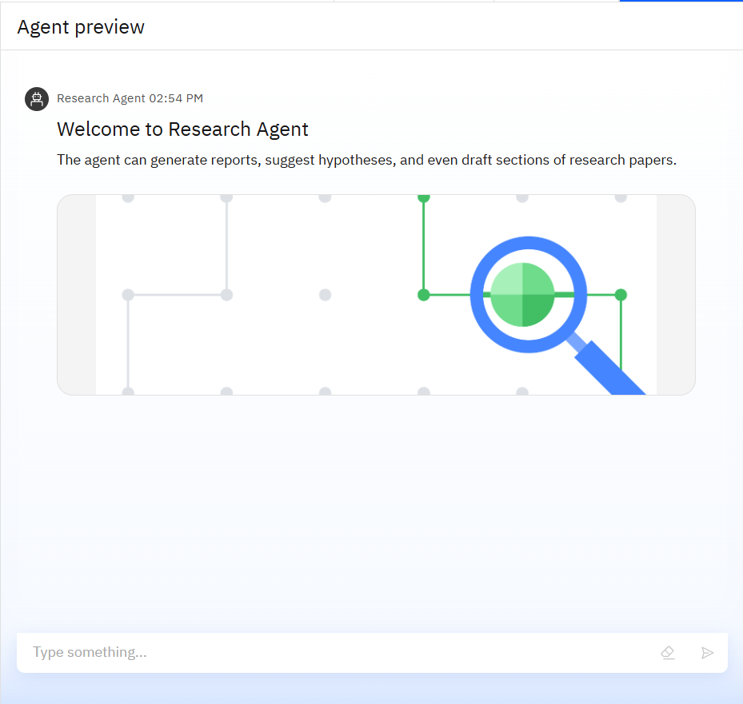
Results
Deployed AI Agent
The Research Agent is successfully deployed and ready for interaction.
It can generate reports, suggest hypotheses, and draft sections of research papers,
streamlining academic workflows and enhancing research efficiency.

Slide 9
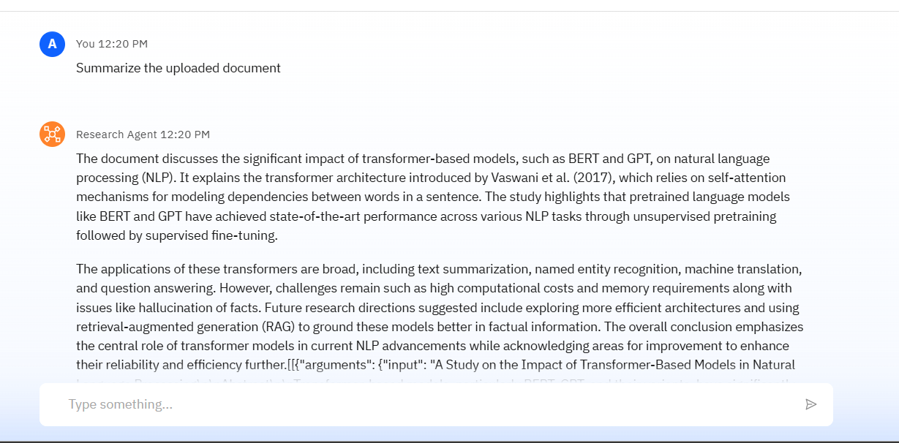
Results
The Research Agent successfully processed an uploaded research document and generated a concise summary.
This shows how the agent condenses complex research into concise, useful insights.

Slide 10
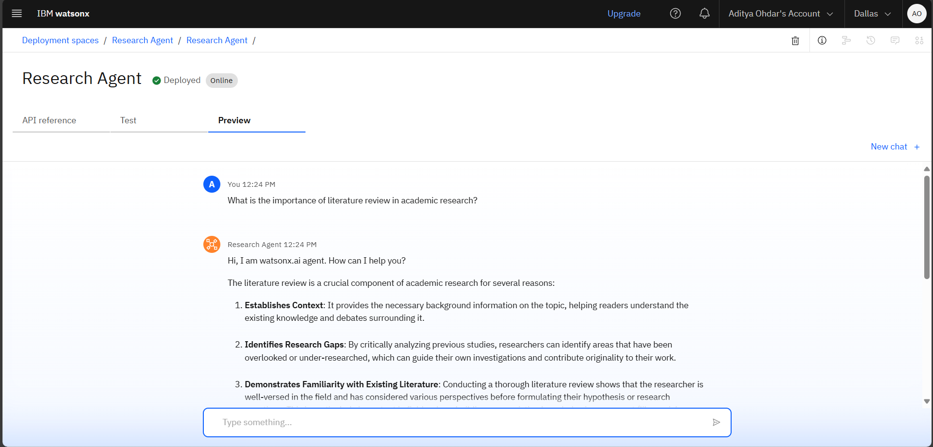
Results

Slide 11
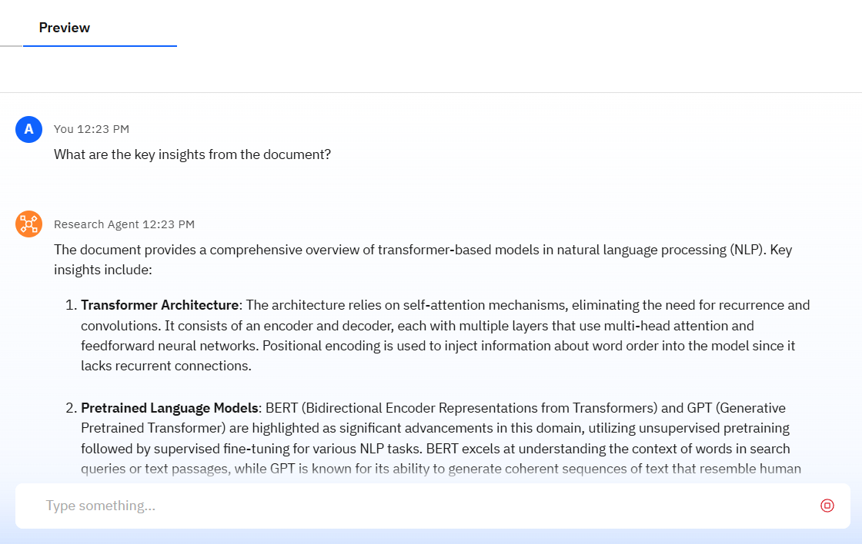
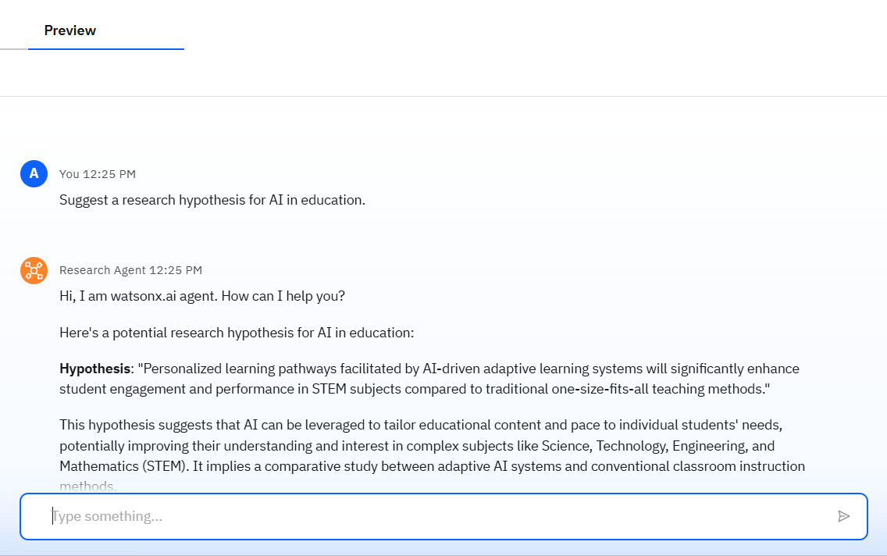
Results
Some More Outputs

Slide 12
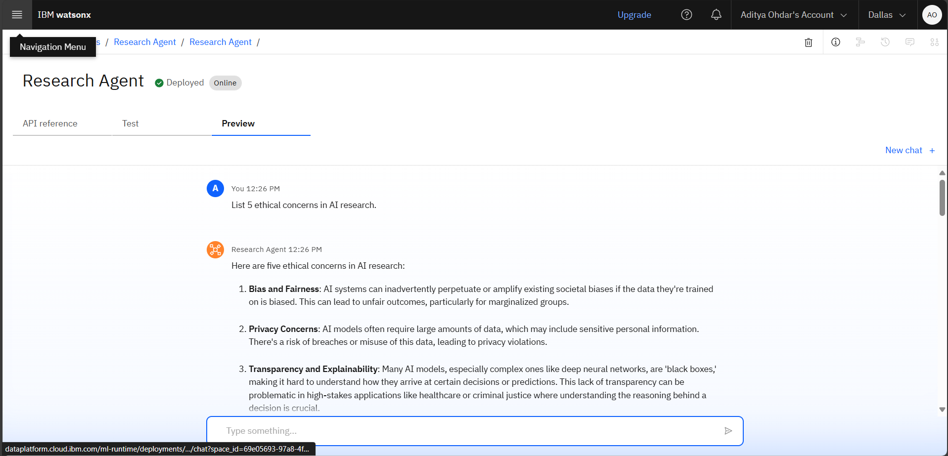
Results
Some More Outputs
Outputs of Any Related Questions

Slide 13
Conclusion
Accelerates Research – Reduces literature review time by quickly summarizing and analyzing papers.
Supports Innovation – Frees up researchers’ time to focus on creative and experimental work.
Accessible Knowledge – Makes research findings more understandable and actionable.
Enhances Accuracy – Provides precise and reliable insights using AI-powered NLP models.
Improves Collaboration – Suggests potential co-authors and relevant institutions.
“Empowering Research Through AI”

Slide 14
Future scope
Multilingual Research Support- Summarize and analyze research papers in multiple languages.
Voice-Activated Research Assistant- Enable hands-free querying and interaction.
Real-Time Collaboration Features- Allow multiple researchers to work together on the same project.
Research Gap and Novel Topic Identification- Highlight unexplored areas for future study.
Integration with Publishing Platforms- Seamless submission to journals and conferences.
AI-Assisted Paper Drafting- Generate high-quality research drafts with minimal effort.

Slide 15
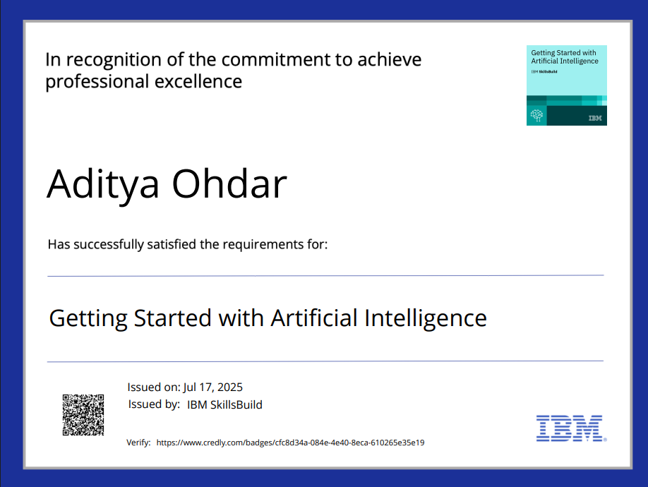
IBM Certifications
Getting Started With Artificial Intelligence

Slide 16
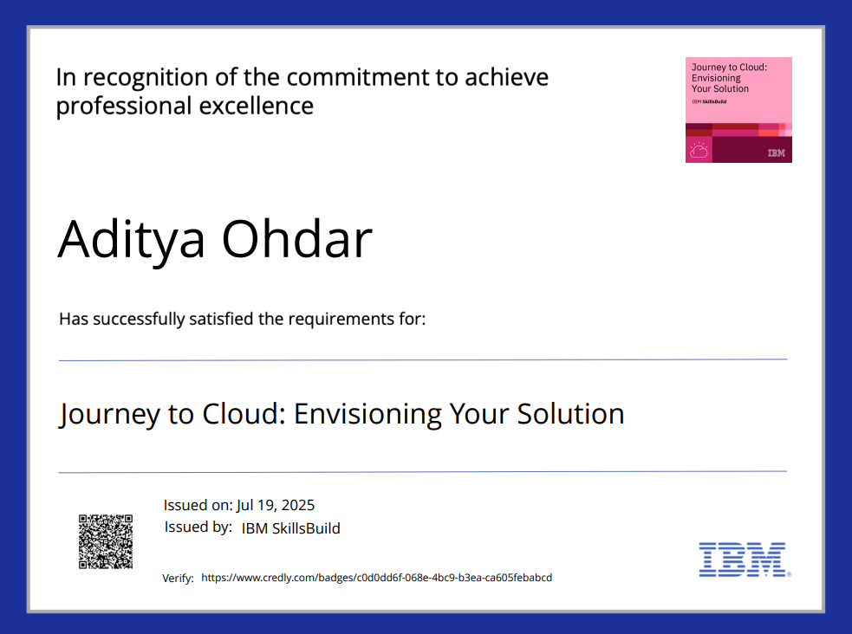
IBM Certifications
Journey toCloud:Envisionong Your Solution

Slide 17
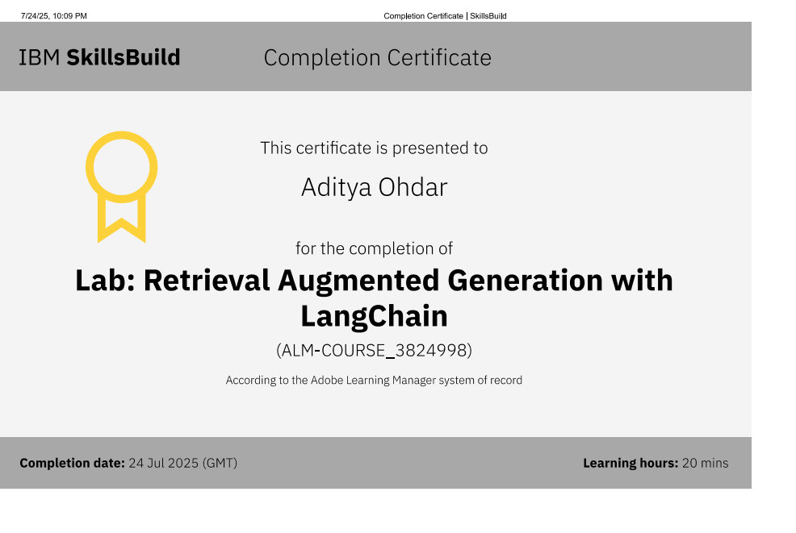
IBM Certifications
Lab: Retrieval Augmented Generation With LangChain

Slide 18
GitHub Link
GitHub Repository Link:https://github.com/Ohdaradi/Research-Agent

Slide 19
THANK YOU

